Slide 1
Presentation brief for MCT’s
Title of presentation | Transform data with Azure Data Factory or Azure Synapse Pipelines
Presentation\Lab length | Presentation: 15 - 20 minutes Lab: 70 – 80 minutes
Audience | Data Engineers, Data Scientists, Data Professionals, Data Architects, BI Professionals, Developers
Purpose | Introduce Azure Data Factory (ADF)/Synapse Pipelines and how it can help in the batch processing of data Understand how Azure Data Factory/Synapse Pipelines can be used to integrate many other technologies together
(think) Student key takeaways | The student should be able to explain the components of Azure Data Factory/Azure Synapse Pipelines The student should be able to use the mapping data flow The student should be able to monitor executing pipelines
(feel) Student desired mindset | The student may feel that this is complex, and it is your teaching that will bring confidence to them The student may like they are not sure what transformation is and the options available to do it in ADF
(do) Student outcomes | The student should be able each component of Azure Data Factory/Azure Synapse Pipelines The student should be able to us the mapping data flow in Azure Data Factory/Azure Synapse Pipelines
More information | For MCT course feedback, visit the Microsoft Official Courseware forum
Notes:
Instructor notes and guidance.
This slide is for MCT use only, outlining the aims and objectives of this module.

Slide 2
DP-203T00: Transform data with Azure Data Factory or Azure Synapse Pipelines
Notes:
Instructor notes and guidance.
If you have taught DP-200, Implementing an Azure Data Solution, this module will be familiar as it uses content from module 7 of that course to teach Azure Data Factory/Azure Synapse Analytics Pipelines. There are new labs for the students to explore, and we have provided examples of how to deal with “dirty data sources” to provide a contrived example of dealing with data sources. The first part of this modules should be focused on the components of Azure Data factory. In fact, you could run this two minute animation on this page as an introduction to the components before you go deeper with the learning
Understand Azure Data Factory components - Learn | Microsoft Docs
The second part of the module explores Mapping Data Flow. Our recommendation is that you show a small example that incorporates the following
How to start the mapping data flow
How to add a source
How to add 1 transformation
How to add a sink
Beyond that, explain to the students that they will learn more by using it in the lab. As a result, we have provided two mapping data flow examples in the lab for them to explore.

Slide 3

Agenda
Lesson 01 – Data integration with Azure Data Factory or Azure Synapse Pipelines
Lesson 02 – Code-free transformation at scale with Azure Data Factory or Azure Synapse Pipelines
Notes:
Instructor notes and guidance.
This space has been left deliberately blank.

Slide 4







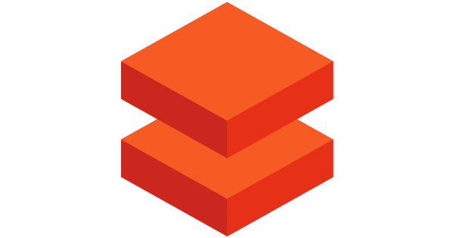
Data integration with Azure Data Factory or Azure Synapse Pipelines
@
Triggers
Parameters
Linked Service
IR
Integration
Runtime
CF
Control
Flow
Pipeline
Data Lake Store
1
Activities
Azure Databricks
Dataset
Notes:
Talking points
Let’s have a closer look at the components of Azure Data Factory
Linked services
Linked services are much like connection strings, which define the connection information that's needed for Data Factory to connect to external resources. Think of it this way: a linked service defines the connection to the data source, and a dataset represents the structure of the data. For example, an Azure Storage-linked service specifies a connection string to connect to the Azure Storage account. Additionally, an Azure blob dataset specifies the blob container and the folder that contains the data.
Linked services are used for two purposes in Data Factory:
To represent a data store that includes, but isn't limited to, an on-premises SQL Server database, Oracle database, file share, or Azure blob storage account. For a list of supported data stores, see the copy activity article.
To represent a compute resource that can host the execution of an activity. For example, the HDInsight Hive activity runs on an HDInsight Hadoop cluster. For a list of transformation activities and supported compute environments, see the transform data article.
Datasets
Datasets represent data structures within the data stores, which simply point to or reference the data you want to use in your activities as inputs or outputs.
Activity
Activities represent a processing step in a pipeline. For example, you might use a copy activity to copy data from one data store to another data store. Similarly, you might use a Hive activity, which runs a Hive query on an Azure HDInsight cluster, to transform or analyze your data. Data Factory supports three types of activities: data movement activities, data transformation activities, and control activities.
Pipeline
A data factory might have one or more pipelines. A pipeline is a logical grouping of activities that performs a unit of work. Together, the activities in a pipeline perform a task. For example, a pipeline can contain a group of activities that ingests data from an Azure blob, and then runs a Hive query on an HDInsight cluster to partition the data.
The benefit of this is that the pipeline allows you to manage the activities as a set instead of managing each one individually. The activities in a pipeline can be chained together to operate sequentially, or they can operate independently in parallel.
Triggers
Triggers represent the unit of processing that determines when a pipeline execution needs to be kicked off. There are different types of triggers for different types of events.
Pipeline runs
A pipeline run is an instance of the pipeline execution. Pipeline runs are typically instantiated by passing the arguments to the parameters that are defined in pipelines. The arguments can be passed manually or within the trigger definition.
Parameters
Parameters are key-value pairs of read-only configuration. Parameters are defined in the pipeline. The arguments for the defined parameters are passed during execution from the run context that was created by a trigger or a pipeline that was executed manually. Activities within the pipeline consume the parameter values.
A dataset is a strongly typed parameter and a reusable/referenceable entity. An activity can reference datasets and can consume the properties that are defined in the dataset definition.
A linked service is also a strongly typed parameter that contains the connection information to either a data store or a compute environment. It is also a reusable/referenceable entity.
Control flow
Control flow is an orchestration of pipeline activities that includes chaining activities in a sequence, branching, defining parameters at the pipeline level, and passing arguments while invoking the pipeline on-demand or from a trigger. It also includes custom-state passing and looping containers, that is, For-each iterators.
Integration Runtime
Integration Runtime is referenced by the linked service or activity, and provides the compute environment where the activity either runs on or gets dispatched from. Data Factory offers three types of Integration Runtime, and you should choose the type that best serve the data integration capabilities and network environment needs you are looking for. These three types are:
Azure - Copying between two cloud data sources:
Self-hosted - Copying between a cloud data source and a data source in private network
Azure-SSIS - Copying between two data sources in private network (only supported in Azure Data Factory, not Azure Synapse Pipelines)
Instructor notes and guidance.
This slide is a build slide, please make sure that you are familiar with the order that the items appear.
Click 1 – Enable you to speak about Linked Services:
Click 2 – Use Data Lake Store as a storage resource example
Click 3 – Use Databricks as a compute resource example
Click 4 – Enables you to talk about the Dataset object
Click 5 – this is a graphic to show a flow of data
Click 6 – Bring up the word activity
Click 7 – shows a rotating cog to reflect a single activity
Click 8 – removes the word activity
Click 9 - shows multiple rotating cogs to reflect multiple activities
Click 10 – Shows a funnel with the word pipeline to show that activities are grouped into a pipeline.
Click 11 – The word trigger appears with a circular arrow
Click 12 – The circular arrow rotates to indicate that a pipeline is triggered to execute
Click 13 - nothing happens
Click 14 – a number 1 appears out of the data and flows through the pipeline into the data set to reflect data being transformed by the activities in a pipeline
Click 15 - The word Parameters with an @ symbol appears
Click 16 – The word Integration runtime appears with an IR icon
Click 17 - The word Control Flow appears with the CF icon
Recommended reading for this slide
Data integration with Azure Data Factory - Learn | Microsoft Docs

Slide 5
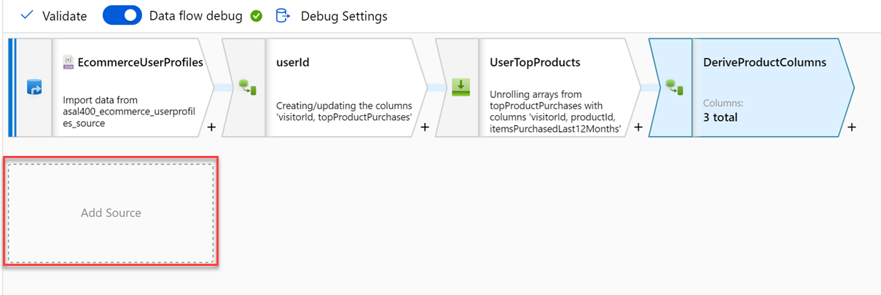
Code-free transformation at scale with Azure Data Factory or Azure Synapse Pipelines
Notes:
Talking points
Let’s dive into the data flow mapping
Mapping data flows are visually designed data transformations in Azure Data Factory or Azure Synapse Pipelines.
Data flows allow data engineers to develop graphical data transformation logic without writing code.
The resulting data flows are executed as activities within Azure Data Factory pipelines that use scaled-out Spark clusters.
Data flow activities can be operationalized via existing Data Factory scheduling, control, flow, and monitoring capabilities. Mapping data flows provide a fully visual experience with no coding required.
Your data flows will run on your own execution cluster for scaled-out data processing. Azure Data Factory handles all the code translation, path optimization, and execution of your data flow jobs.
Data Flow mapping brings the following benefits and capabilities:
- Perform data cleansing, transformation, aggregations, etc.
- Enables you to build resilient data flows in a code free environment
- Enable you to focus on building business logic and data transformation
- Underlying infrastructure is provisioned automatically with cloud scale via Spark execution
Like many data transformation tools, Mapping Data Flow in Azure Data factory supports a great variety of data transformations.
Instructor notes and guidance.
Note that this content is valid for both Azure Data Factory and Azure Synapse Pipelines. Consider showing an example through a demo, you should consider replaying some of the activities done in the lab. The feedback from MCTs about DP200 is that many students needed help the ADF lab, so replaying the mapping data flow should be considered
Recommended reading for this slide
Code-free transformation at scale with Azure Data Factory - Learn | Microsoft Docs

Slide 6
Review questions
Q01 – You are moving data from an Azure Data Lake Gen2 store to Azure Synapse Analytics. Which Azure integration runtime would be used?
A01 – Azure
Q02 – Which control activity can be used to branch an activity on a condition that evaluates to true or false?
A02 – If Condition activity
Q03 – What feature enables you to interact with the Mapping Data Flow transformations that you create?
A03 – Debug
Notes:
Instructor notes and guidance.
This space has been left deliberately blank

Slide 7
Lab: Transform data with Azure Data Factory or Azure Synapse Pipelines
Notes:
Instructor notes and guidance.
This space has been left deliberately blank

Slide 8
Lab overview
This lab teaches students how to build data integration pipelines to ingest data from multiple data sources, transform data using mapping data flows and notebooks, and perform data movement into one or more data sinks.
Lab objectives
After completing this lab, you will be able to:
Data integration with Azure Data Factory or Azure Synapse Pipelines
Code-free transformation at scale with Azure Data Factory or Azure Synapse Pipelines
Notes:
Instructor notes and guidance.
This lab teaches students how to build data integration pipelines to ingest data from multiple data sources, transform data using mapping data flows and notebooks, and perform data movement into one or more data sinks.
In exercise 1. the students will create the required objects; namely SQL tables, that will be used to store the data that is ingested by the mapping data flow. Then they will define the required linked services to connect to the data sources to consume the data, followed by pointing to the datasets within the linked services. Note that the students will be dealing with a poorly formatted data while creating these datasets, and how to handle it in a linked service.
In exercise 2, and exercise 3, the students will use a Mapping Data Flow to create a campaign analytics data pipeline, and the top product purchases respectively. This gives the students a couple of examples of how the Mapping data flow can be used to transform data using Azure Data Factory/Azure Synapse pipelines.
In exercise 4, the students will trigger the execution of their work, and learn how they can monitor the execution of the pipelines that they have created.

Slide 9











Lab 08 Overview
asacosmosdb<unique_suffix>
CosmosDB
Campaign Info
Azure Databricks
asagadatalake<unique_suffix>
Cluster
Azure Data Lake
wwi-02
Profiles (json)
dp203sql<unique_suffix>
SourceDB
Synapse Analytics
Dedicated SQL Pool (SQLPool1)
Built-In Serverless SQL Pool
Apache Spark pool
Pipelines and Dataflows
Power BI
asagaworkspace<unique_suffix>
Notes:
This slide is an optional slide that you can use to show a high-level overview of the technologies used in the lab.
This lab teaches students how to build data integration pipelines to ingest from multiple data sources, transform data using mapping data flows and notebooks, and perform data movement into one or more data sinks.

Slide 10
Lab review
Question 1 – What are the first two components do you create in Azure Data Factory/Azure Synapse Pipelines to connect to data in a data source?
Question 2 – Which mapping data flow transformation enables you to remove records during the execution of a data flow?
Question 3 – How can you save and persist the work that you create in Azure Data Factory/Azure Synapse Pipelines?
Question 4 – How can you view detailed information about a data flow?
Notes:
Answers
Question 1 –You first create a linked service, followed by an integration dataset to connect to data in a data source
Question 2 – The filter transformation enables you to remove records during the execution of a data flow.
Question 3 – It is very important to click on Publish/Publish All. Otherwise you will loose any work that you have created
Question 4 – In the monitor section, click on Pipeline runs, click on the data flow of interest, and then click on the Data flow details icon (represented by a glasses icon) to view the detailed information

Slide 11
Module summary
In this module, you have learned about:
Data integration with Azure Data Factory or Azure Synapse Pipelines
Code-free transformation at scale with Azure Data Factory or Azure Synapse Pipelines
Next steps
After the course, consider visiting [the Microsoft Customer Case Study site]. Use the search bar to search by an industry such as healthcare or retail, or by a technology such as Azure Synapse Analytics or Azure Data Factory. Read through some of the customers stories
Notes:
Instructor notes and guidance.
The next steps is suggested post course learning materials to reinforce what they have learned in the module.

Slide 12
Closing slide
Notes:
Instructor notes and guidance.
This space has been left deliberately blank

